Slide 1
RUSTikales Rust for beginners

Slide 2
Plan for today

Slide 3
Plan for today
Recap

Slide 4
Plan for today
Recap
Traits

Slide 5
Recap

Slide 6
Recap
Ownership-Model
References
Borrow Checker

Slide 7
Recap
Ownership-Model
References
Borrow Checker
Structs
Declared using the keyword struct
Made out of fields
Are type definitions

Slide 8
Recap
Ownership-Model
References
Borrow Checker
Structs
Associated functions
Declared using the keyword impl for a given type
Functions are linked to a type
Called via struct::fn_name()

Slide 9
Recap
Ownership-Model
References
Borrow Checker
Structs
Associated functions
Methods
Associated functions where the first parameter is either self, &self or &mut self
Called on instances of structs using the dot operator

Slide 10
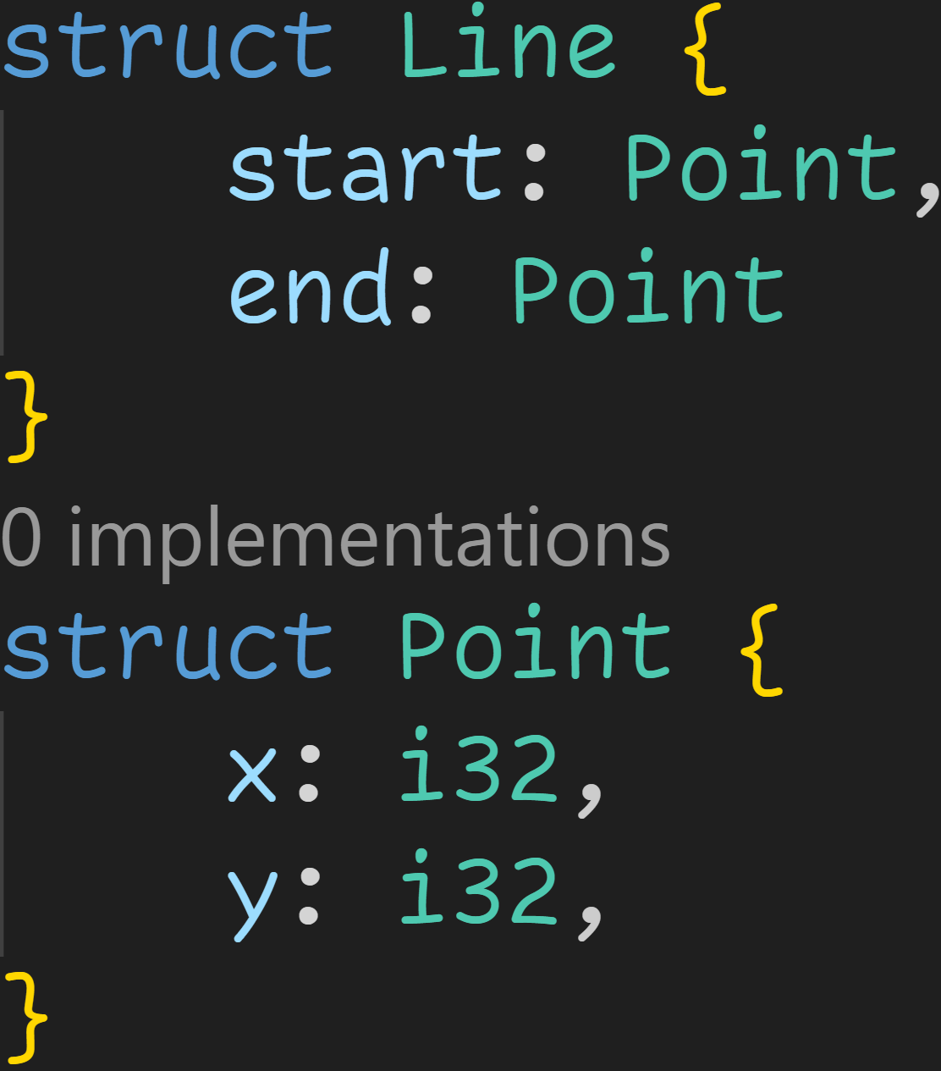
Recap

Slide 11
Recap
Struct declaration

Slide 12
Recap
Lines are made out of two fields

Slide 13
Recap
As with most top-level keywords, structs can be declared in any order

Slide 14
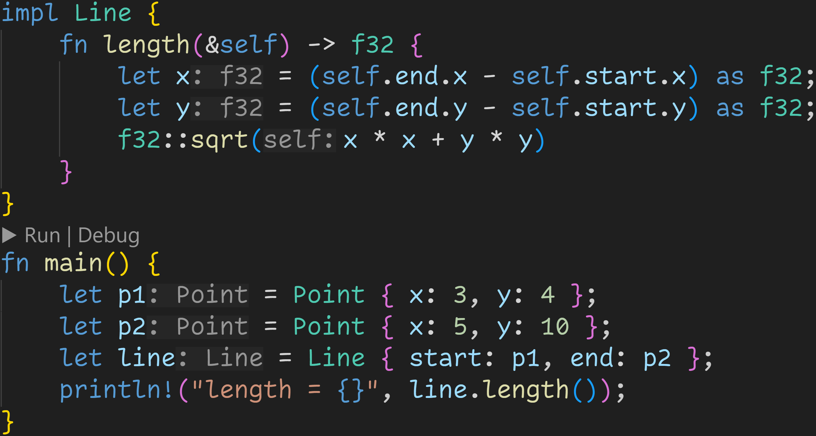
Recap

Slide 15
Recap
p1 and p2 are instances of type Point

Slide 16
Recap
Using impl, we can declare functions for given types

Slide 17
Recap
Associated function
→ More precise, a method

Slide 18
Recap
Takes a reference to an instance of type Line
→ self and Self are special identifiers

Slide 19
Recap
Call to an associated function of f32

Slide 20
Recap
Type hint suggests that this is a method
→ Methods are special associated functions and can be called as such

Slide 21
Recap
We can use the dot operator to call methods
→ line is automatically borrowed and passed as &self

Slide 22
Recap
The dot operator is syntactic sugar
→ Both versions work

Slide 23
Recap
Normal Ownership rules apply
→ p1 and p2 are moved into the line here

Slide 24
Traits

Slide 25
Traits
Structs and methods are very powerful, but currently very limited

Slide 26
Traits
Structs and methods are very powerful, but currently very limited
We can‘t print struct instances to the console
We can only move structs

Slide 27
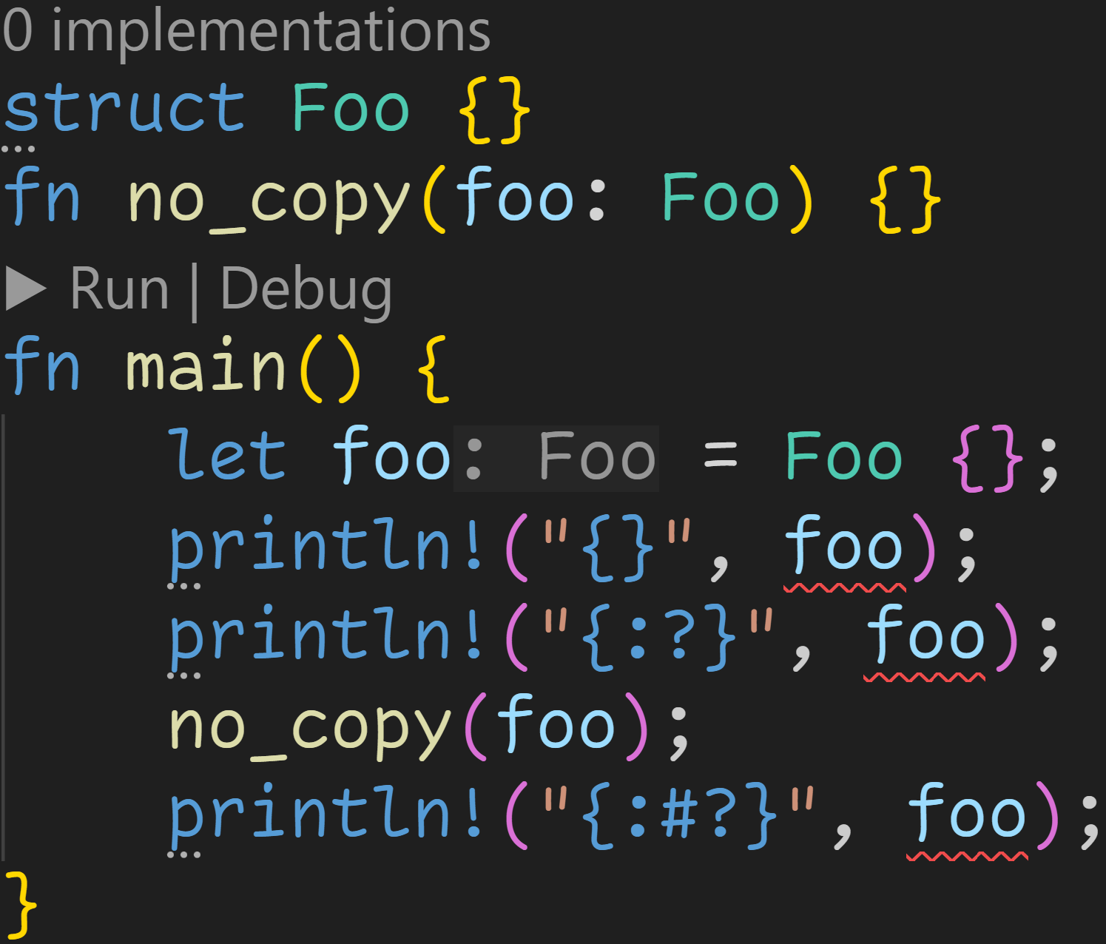
Traits

Slide 28
Traits
Can‘t print normally

Slide 29
Traits
Can‘t debug print

Slide 30
Traits
foo is moved, we can‘t use it below

Slide 31
Traits
Structs and methods are very powerful, but currently very limited
We can‘t print struct instances to the console
We can only move structs
For this and more, Rust has the trait system

Slide 32
Traits
Structs and methods are very powerful, but currently very limited
We can‘t print struct instances to the console
We can only move structs
For this and more, Rust has the trait system
Traits are contracts
A trait is made out of function declarations
If we want to use a trait for a struct, we need to implement those functions

Slide 33
Traits
Structs and methods are very powerful, but currently very limited
We can‘t print struct instances to the console
We can only move structs
For this and more, Rust has the trait system
Traits are contracts
Traits can be defined using the keyword trait
Traits can be implemented for a type using the keyword impl

Slide 34
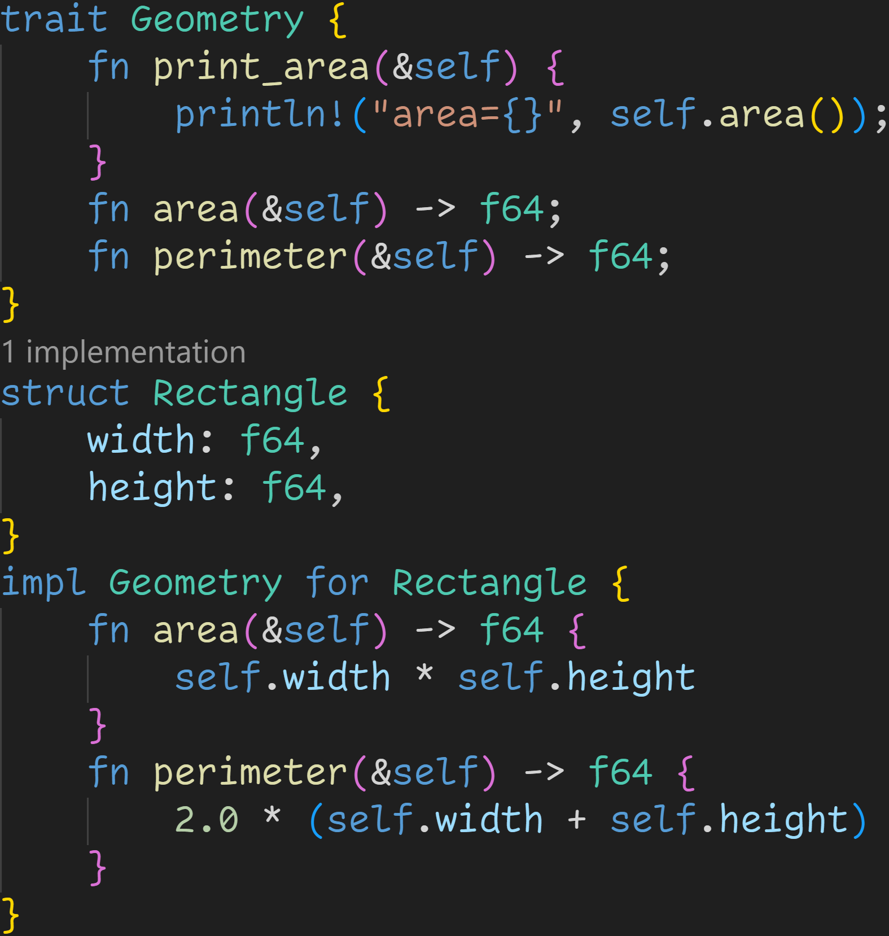

Slide 35
Trait definition

Slide 36
Function declaration

Slide 37
Function definition

Slide 38
Traits are implemented for given types

Slide 39
Implement each function

Slide 40
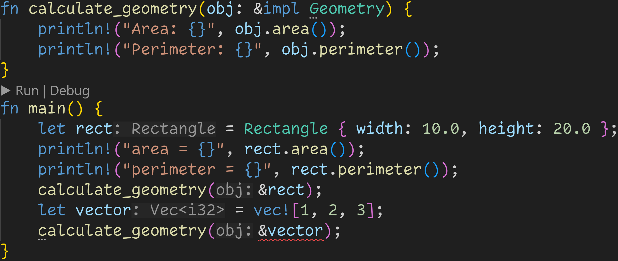

Slide 41
After we implemented a trait, we can call the functions like any other associated function or method

Slide 42
After we implemented a trait, we can call the functions like any other associated function or method
3/3
This seems redundant, why can‘t we simply use impl? What do we gain?

Slide 43
After we implemented a trait, we can call the functions like any other associated function or method
3/3
This seems redundant, why can‘t we simply use impl? What do we gain?
→ We can generalize our code to take in any struct that implements a given trait

Slide 45
We accept every struct that implements the Geometry trait

Slide 46
Traits are contracts
→ We don‘t know the direct type of obj, but we do know that it has those methods

Slide 47
Rectangle implements Geometry, so we can pass instances of type Rectangle

Slide 48
Rectangle implements Geometry, so we can pass instances of type Rectangle Vec does not implement Geometry, so we can‘t pass instances of type Vec

Slide 49
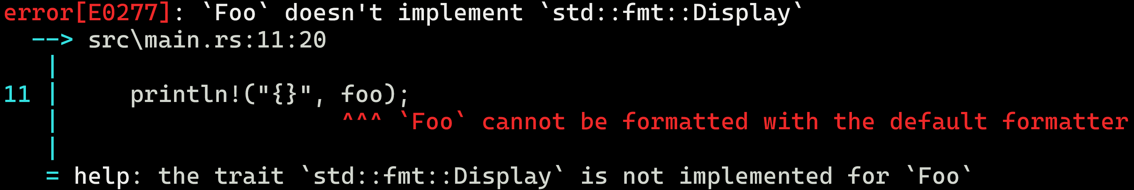
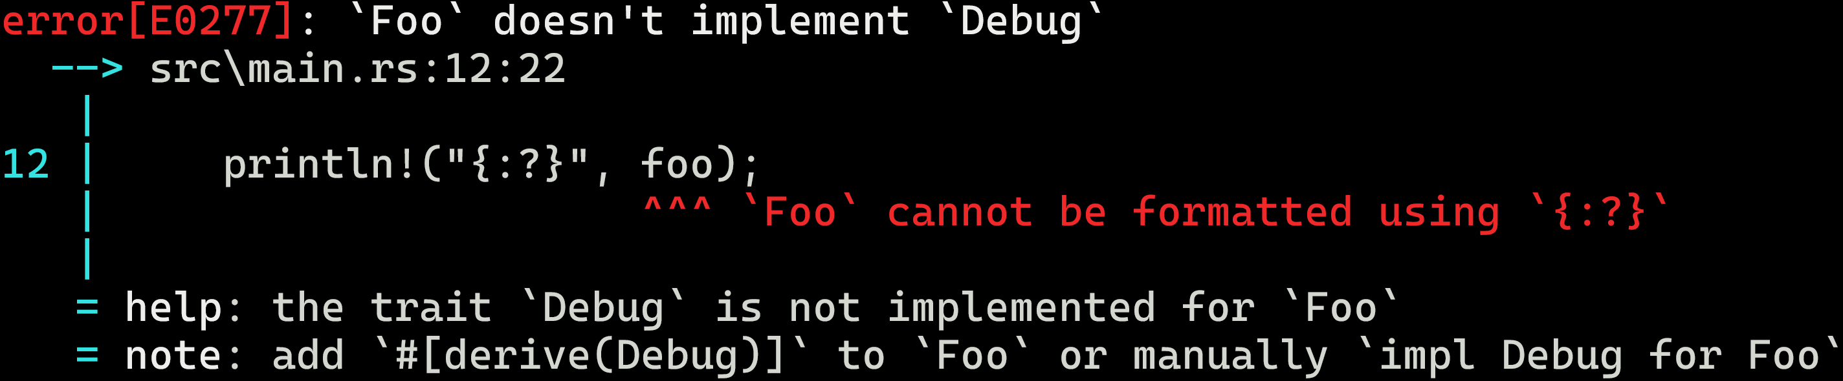
The compiler error for println!(“{}“)
The compiler error for println!(“{:?}“)

Slide 50
The compiler error for println!(“{}“)
The compiler error for println!(“{:?}“)
Aha!

Slide 51
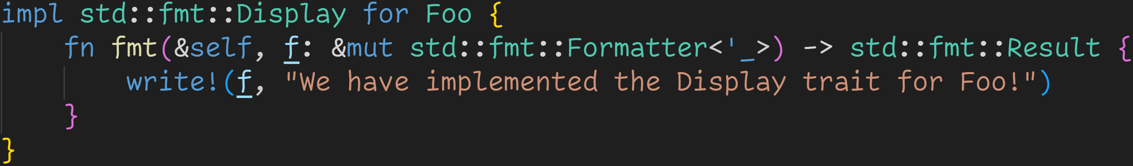
The compiler error for println!(“{}“)

Slide 52
The compiler error for println!(“{}“)
All formatter traits are located in the module std::fmt → They control the behavior of println!() and other macros

Slide 53
The compiler error for println!(“{}“)
They only contain one function that we need to implement

Slide 54
The compiler error for println!(“{}“)
The trait requires that parameter and return type, but we‘ll just leave that to the write!() call

Slide 55
The compiler error for println!(“{}“)
Using write!(), we can now implement Display!
write!() is identical to println!() except that it requires a target instead of writing to the console

Slide 56
The compiler error for println!(“{}“)

Slide 57
Intermission - Strings

Slide 58
Intermission - Strings
write!, format!, print! – A lot of macros make use of Strings

Slide 59
Intermission - Strings
write!, format!, print! – A lot of macros make use of Strings
Rust has two commonly used String types
&str → String slices
String → String structs

Slide 60
Intermission - Strings
write!, format!, print! – A lot of macros make use of Strings
Rust has two commonly used String types
&str → String slices
String → String structs
Slices are special references → They don‘t own the underlying data → &str is not resizable
Strings are Vectors → They own the underlying data → String is resizable

Slide 61
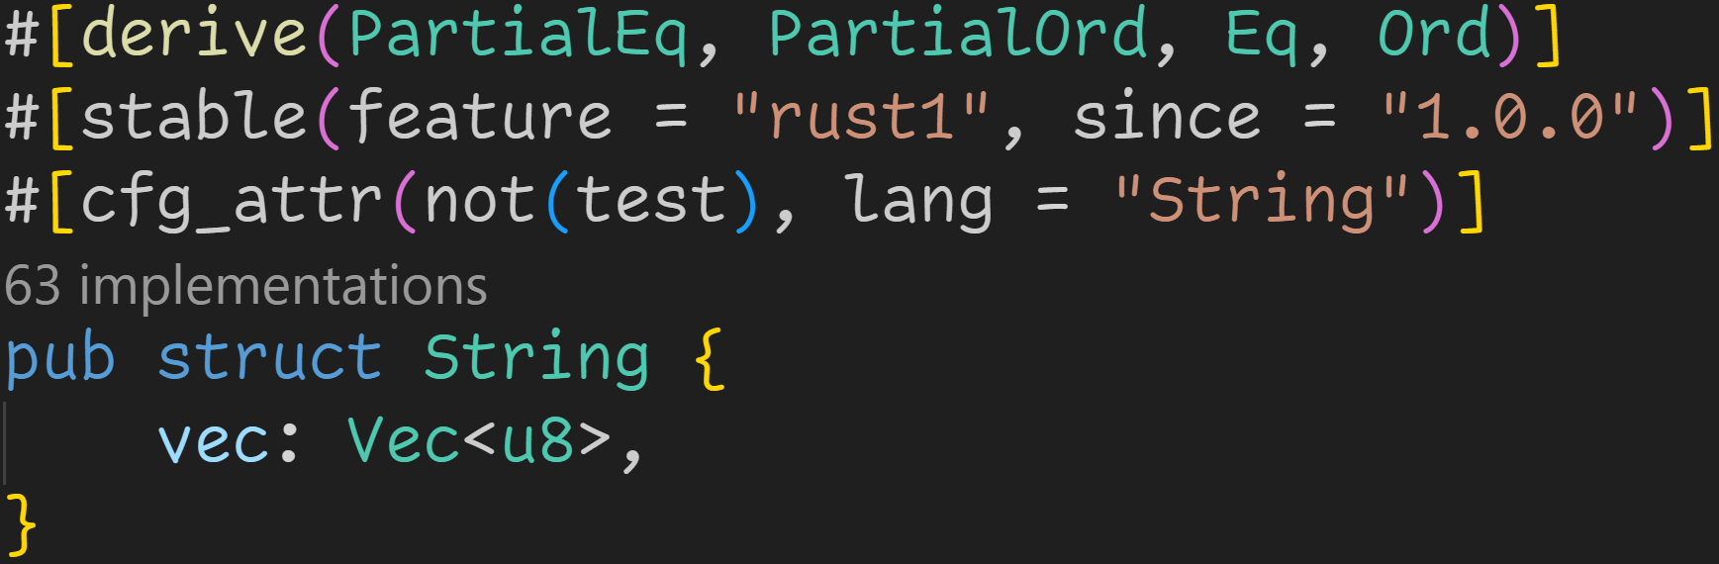
Intermission - Strings
write!, format!, print! – A lot of macros make use of Strings
Rust has two commonly used String types
&str → String slices
String → String structs
Slices are special references → They don‘t own the underlying data → &str is not resizable
Strings are Vectors → They own the underlying data → String is resizable
String is literally a Vector :^)

Slide 62
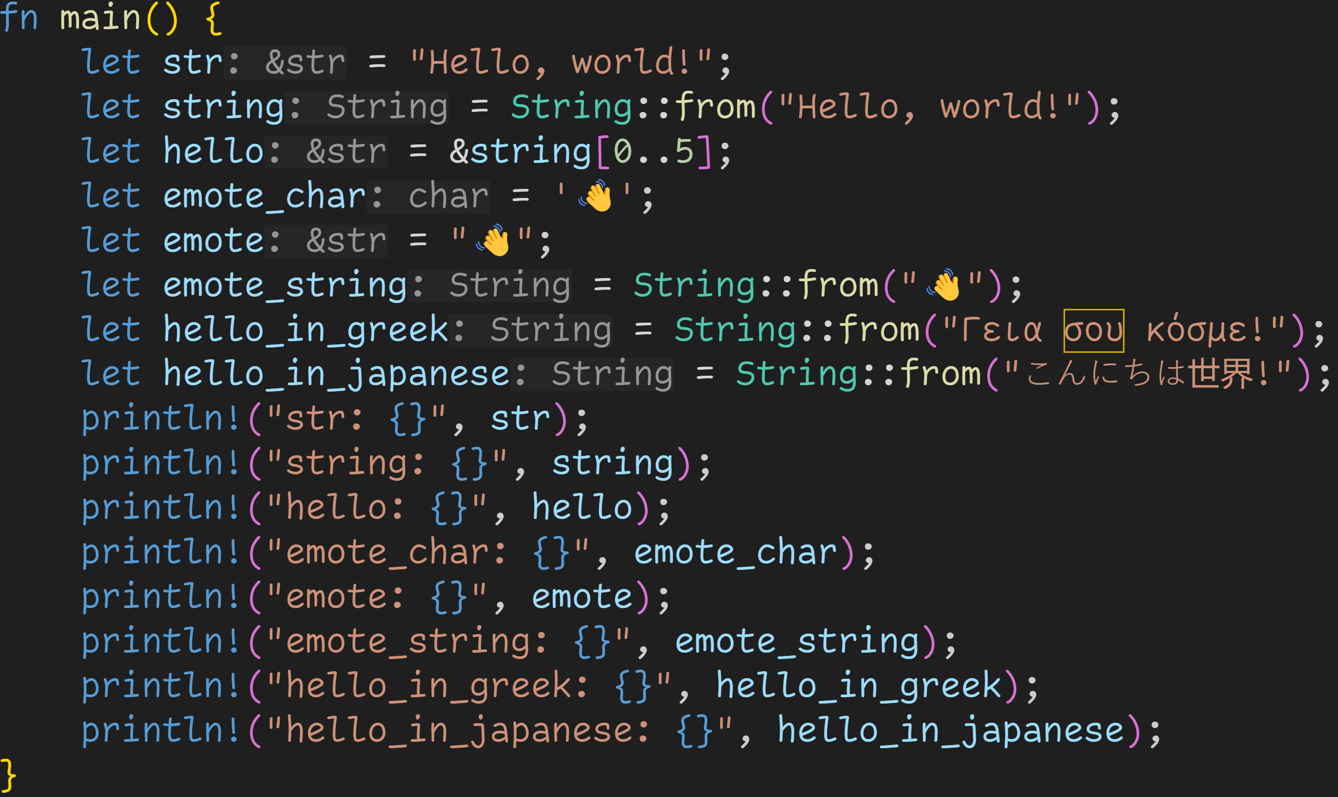

Slide 63
String literals are located in the data section of the executable
→ Third memory region besides Stack and Heap
→ Not resizable

Slide 64
String slices are made of two fields
→ A pointer to the start of some memory → Length in bytes

Slide 65
String slices always borrow underlying data → Data then can be in the data section → Data can also be on the heap

Slide 66
We can create a String instance using String::from(&str) → Creates a copy of the Slice on the Heap → Resizable

Slide 67
Strings in Rust are always valid UTF-8 → We can use emojis, arabic, cyrillic, ... characters

Slide 68
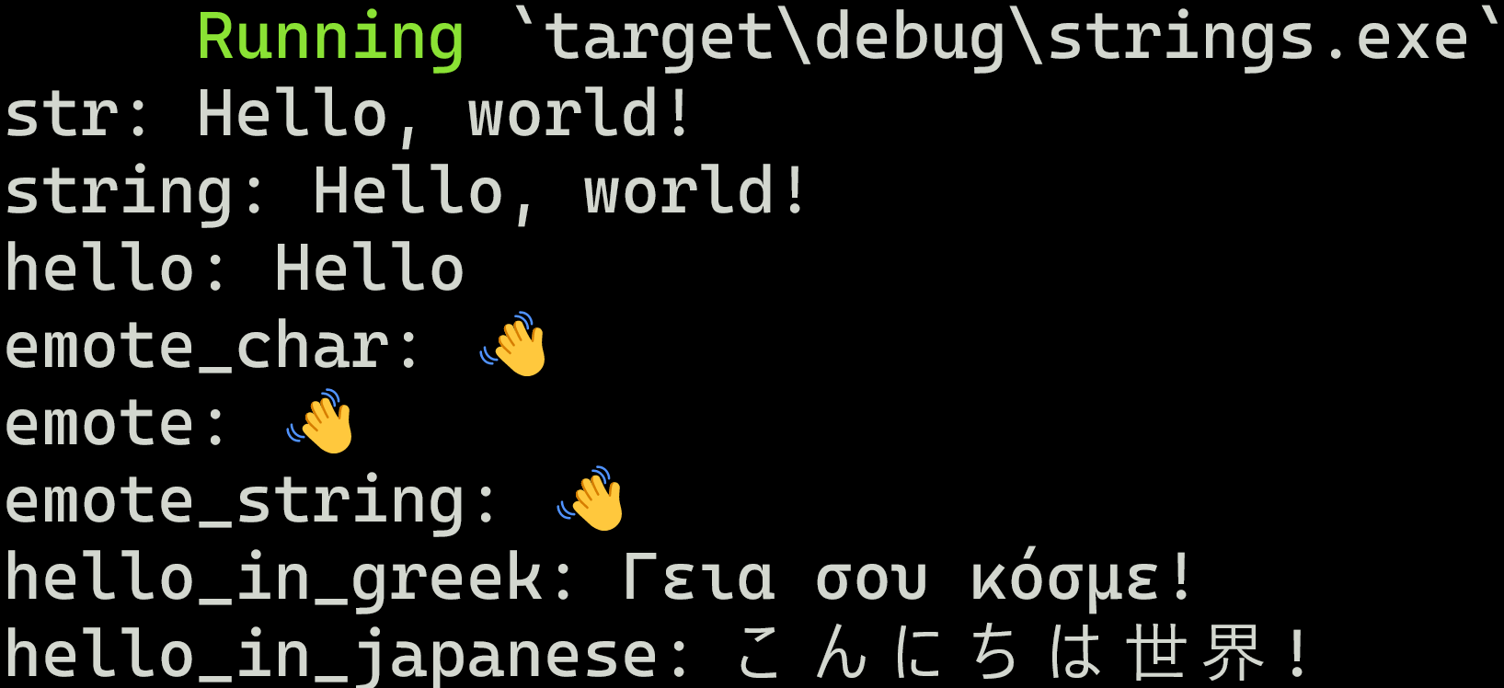

Slide 69
Slice of the first 5 bytes of the String

Slide 70
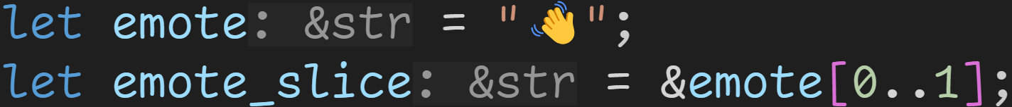
Intermission - Strings
UTF-8 characters can be multiple bytes long
→ Indices are byte boundaries, not glyph boundaries → Rust guarantees valid UTF-8 Strings → Panic at runtime

Slide 71
Intermission - format!()

Slide 72
Intermission - format!()
The format!() macro family is an important tool to turn any value or variable into a String

Slide 73
Intermission - format!()
The format!() macro family is an important tool to turn any value or variable into a String
The first argument is always the format string
String literal in which we can provide placeholders for the values we want to format

Slide 74
Intermission - format!()
The format!() macro family is an important tool to turn any value or variable into a String
The first argument is always the format string
String literal in which we can provide placeholders for the values we want to format
For every placeholder you specify, you need to provide an additional argument
In contrast to functions, macros do allow variable amount of arguments

Slide 75
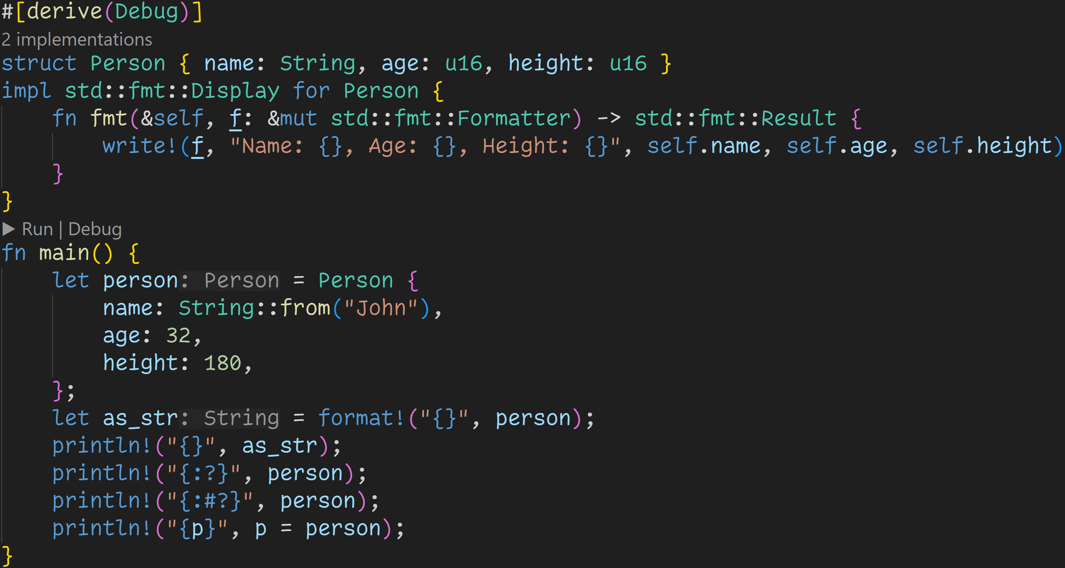

Slide 76
Call to format macro

Slide 77
Format String

Slide 78
Placeholder

Slide 79
One placeholder
→ We need to provide one argument

Slide 80
format!() returns a String which we can then use

Slide 81
println!() is identical to format!(), except that it prints the String instead of returning it

Slide 82
write!() is also part of the family, except that it needs a target to write to

Slide 83
Format String

Slide 84
Three placeholders
→ We need to provide three arguments

Slide 85
We can list different kinds of placeholders
→ {} requires std::fmt::Display → {:?} requires std::fmt::Debug → {:#?} is Debug, but nicely printed ... and many more

Slide 86
Format Strings do allow named arguments

Slide 87
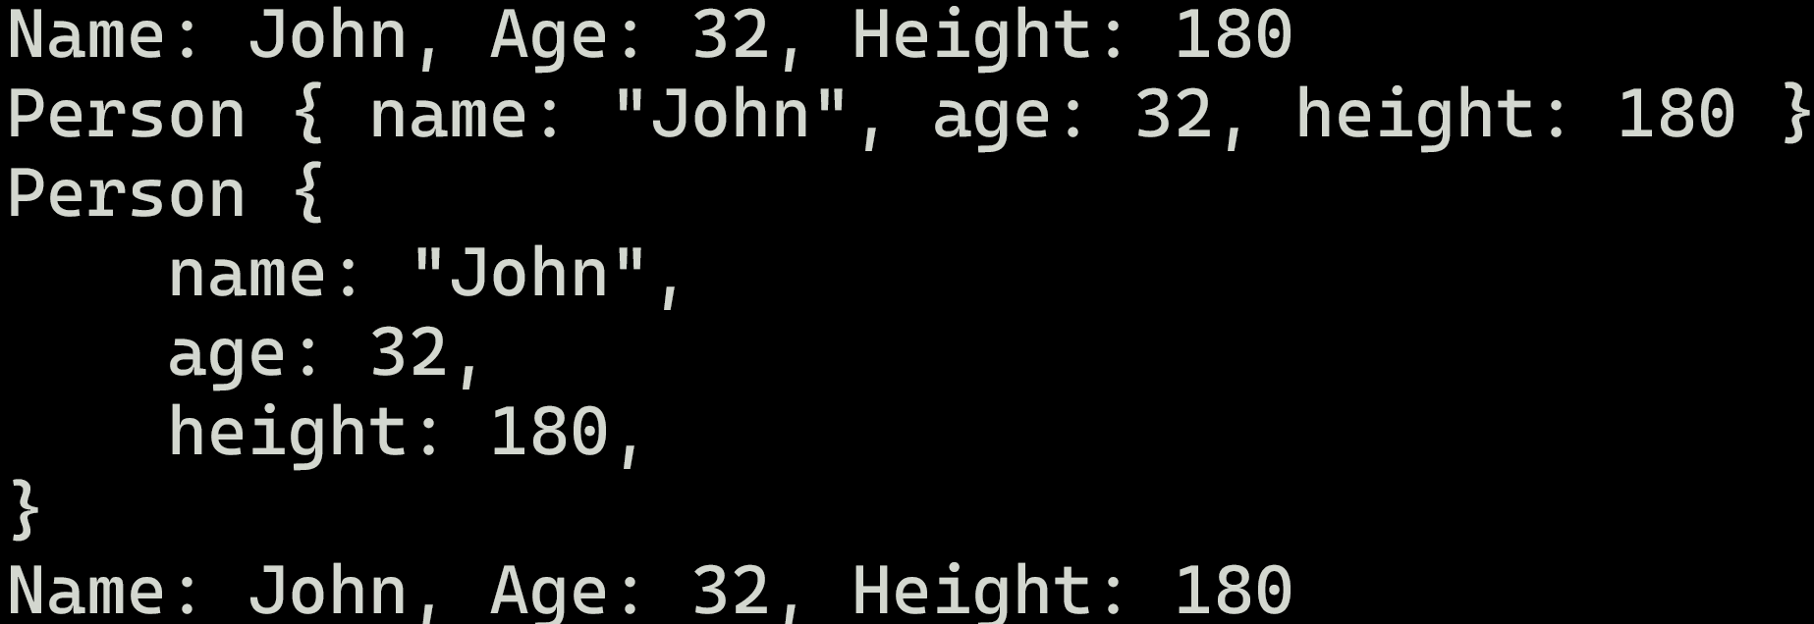

Slide 88
Calls our Display-implementation

Slide 89
Using macros, we can automatically implement some traits

Slide 90
Debug print but with linebreaks

Slide 91
Traits
The trait system controls nearly everything in Rust

Slide 92
Traits
The trait system controls nearly everything in Rust → Arithmetic operations → std::ops::Add, std::ops::Sub etc. → Comparisons → std::cmp::PartialEq, std::cmp::Eq etc. → for-loops → std::iter::Iterator etc. → Move semantics → std::marker::Copy

Slide 93
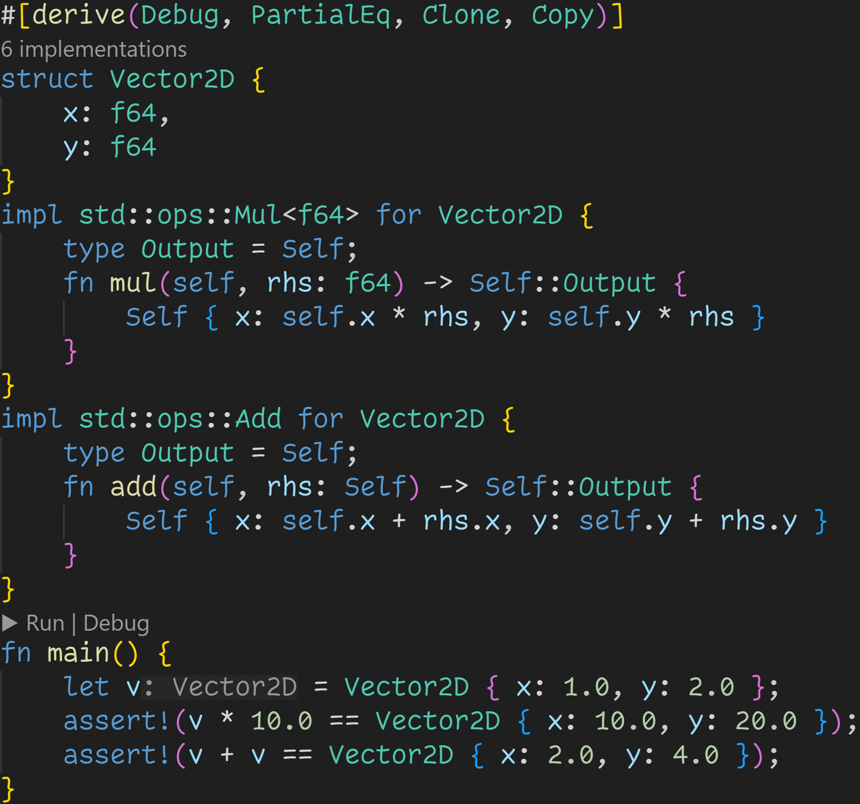

Slide 94
A struct representing a mathematical vector

Slide 95
This implements Vector2D * f64

Slide 96
This implements Vector2D + Vector2D

Slide 97
This implements Vector2D == Vector2D

Slide 98
This moves v, twice!

Slide 99
Rust no longer moves our struct, it copies it :^)
This moves v, twice!

Slide 100
Intermission - Exercises
Time for exercises!

Slide 101
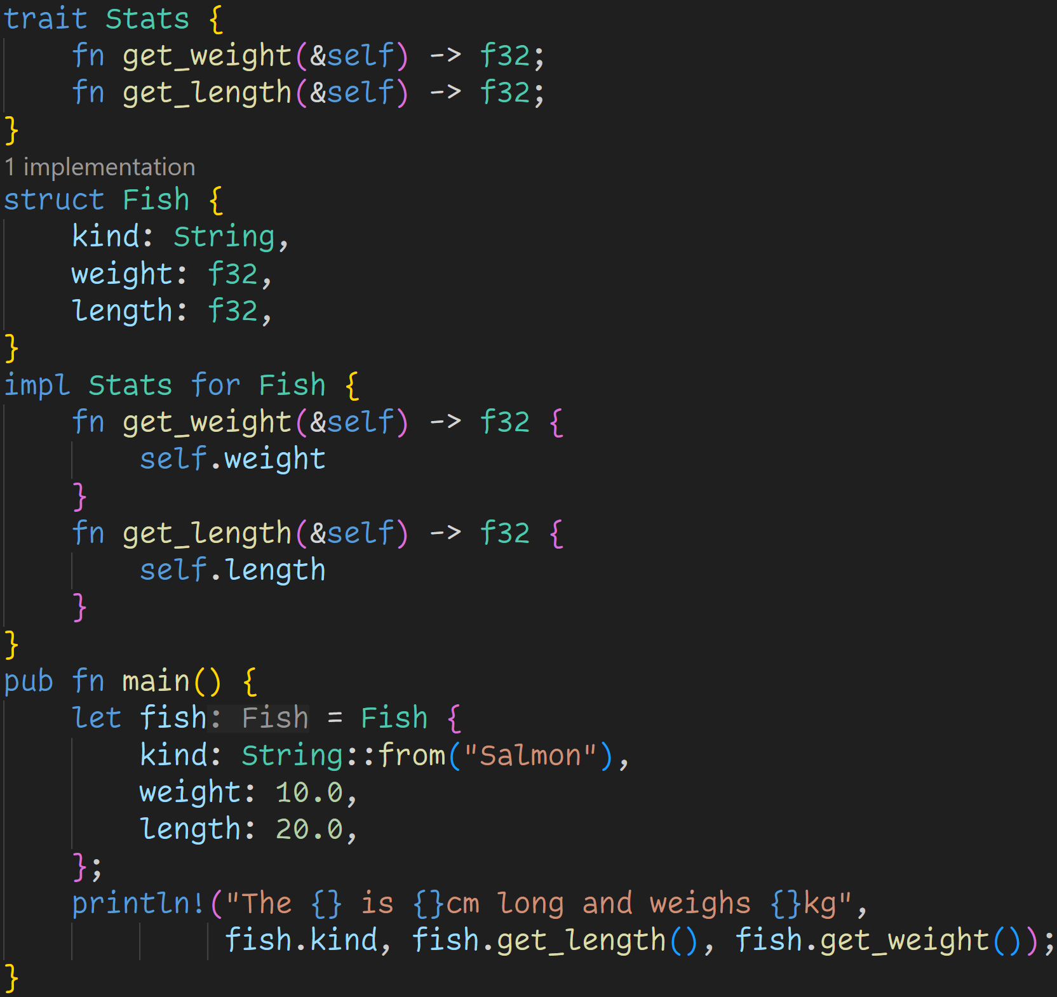
2/3

Slide 102
2/3
Does the code compile?
If yes, what does it print?

Slide 103
2/3
Does the code compile?
If yes, what does it print?
Yes, it does compile!

Slide 104
2/3
Does the code compile?
If yes, what does it print?
Trait definition
Yes, it does compile!
Trait implementation

Slide 105
2/3
Does the code compile?
If yes, what does it print?
Yes, it does compile!
Output

Slide 106
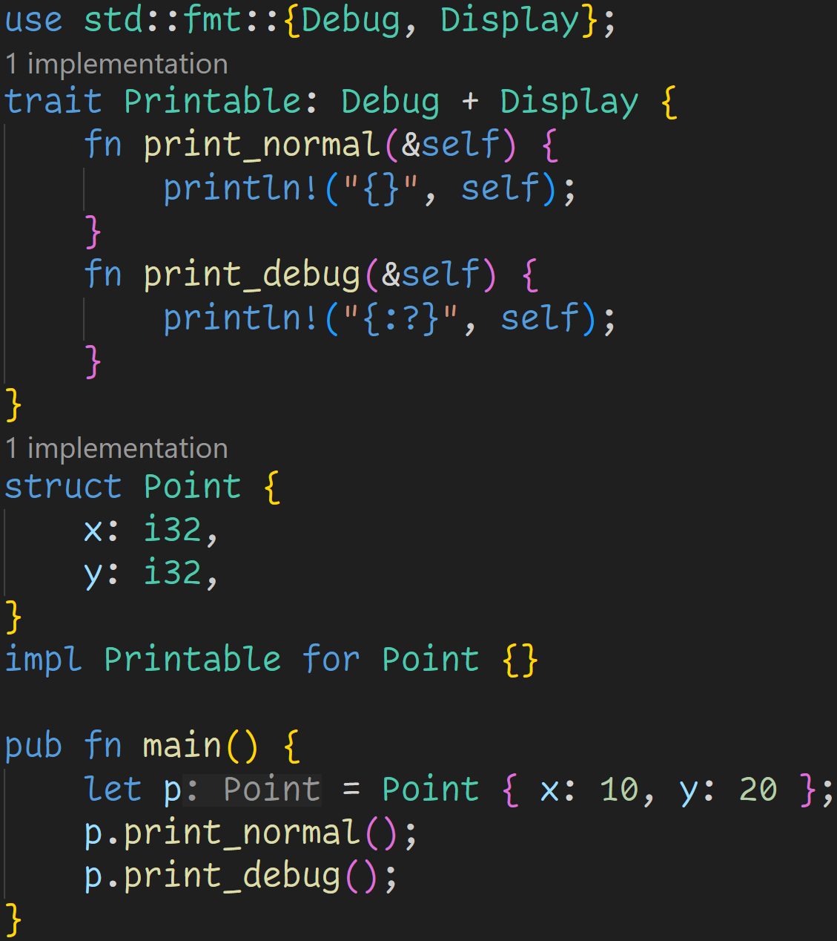
3/3

Slide 107
3/3
Does the code compile?
If yes, what does it print?

Slide 108
3/3
Does the code compile?
If yes, what does it print?
Trait boundary
→ Anything that implements Printable must also implement Debug and Display

Slide 109
3/3
Does the code compile?
If yes, what does it print?
This is fine, Rust takes the default implementations given in the trait definition

Slide 110
3/3
Does the code compile?
If yes, what does it print?
However, our Point does not implement Debug and Display :(

Slide 111
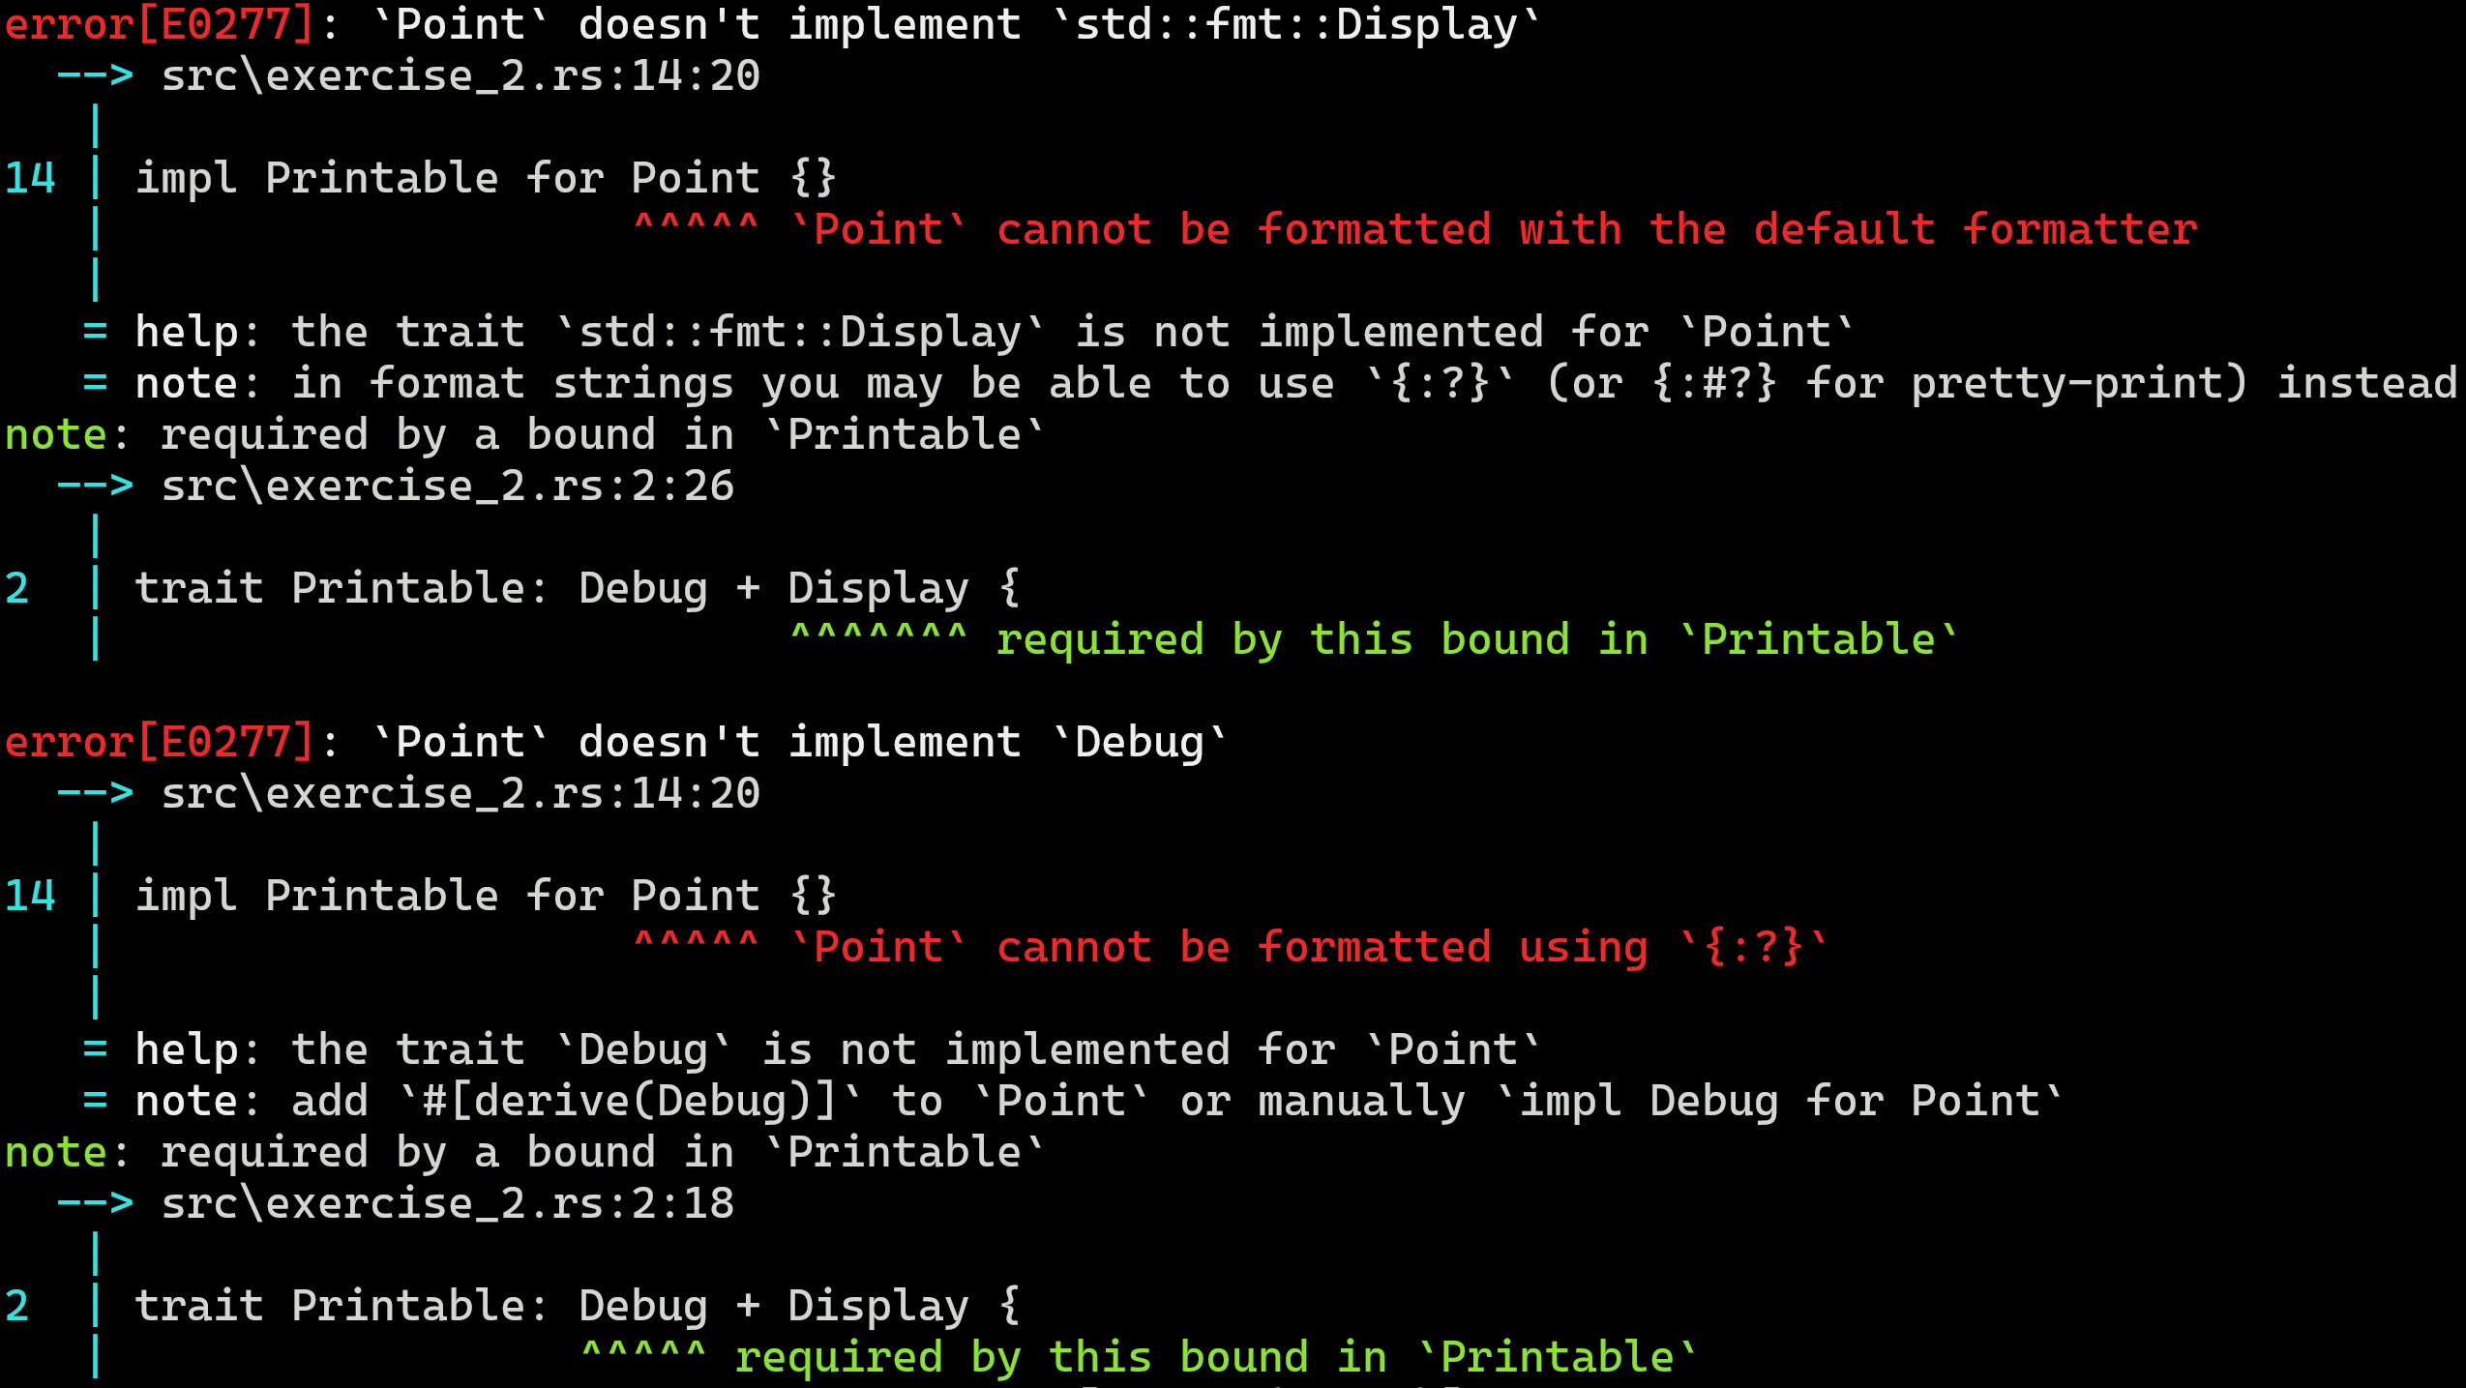
3/3
Does the code compile?
If yes, what does it print?

Slide 112
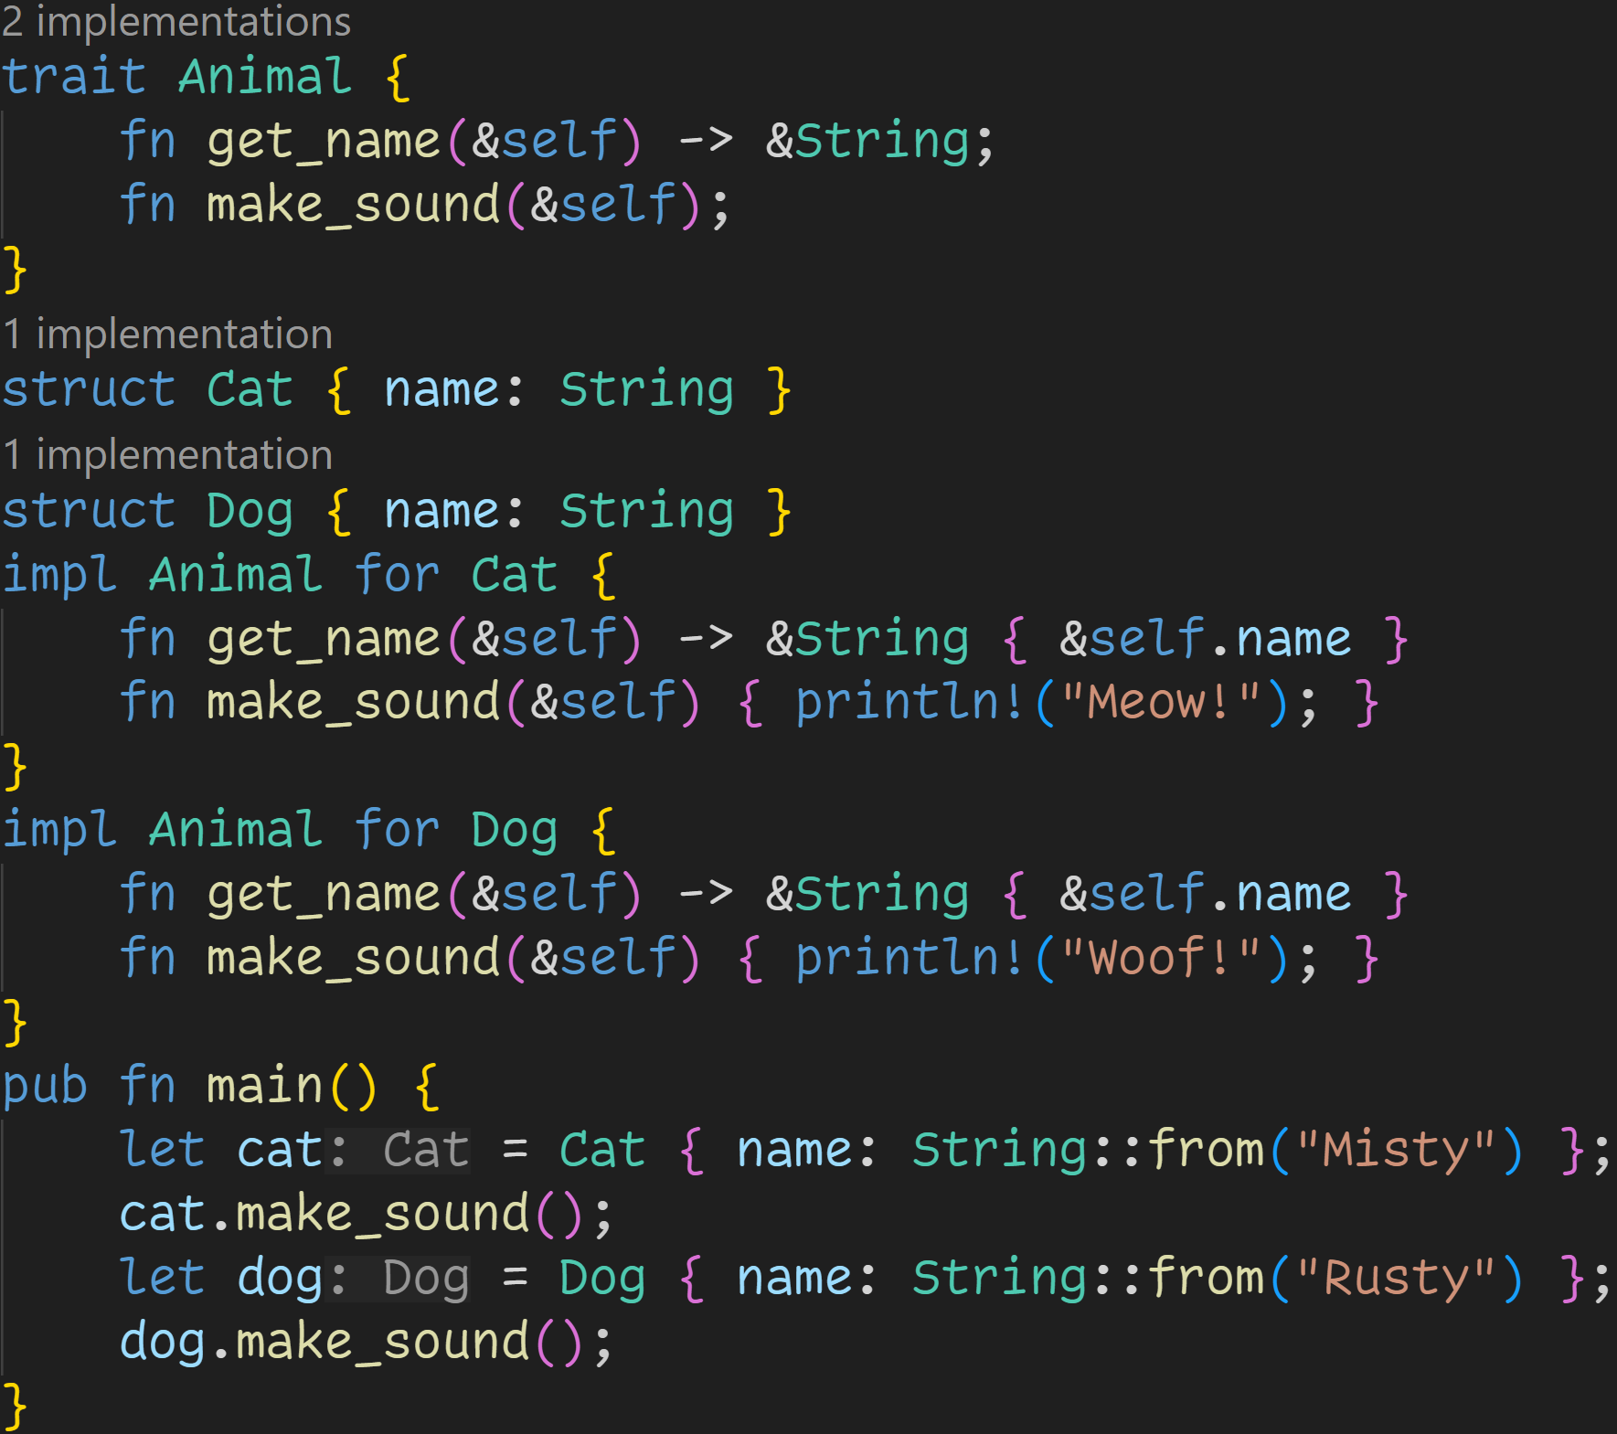
2/3

Slide 113
2/3
Does the code compile?
If yes, what does it print?

Slide 114
2/3
Does the code compile?
If yes, what does it print?
Trait definition
Trait implementations

Slide 115
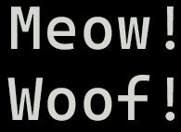
2/3
Does the code compile?
If yes, what does it print?
This code compiles :)

Slide 116
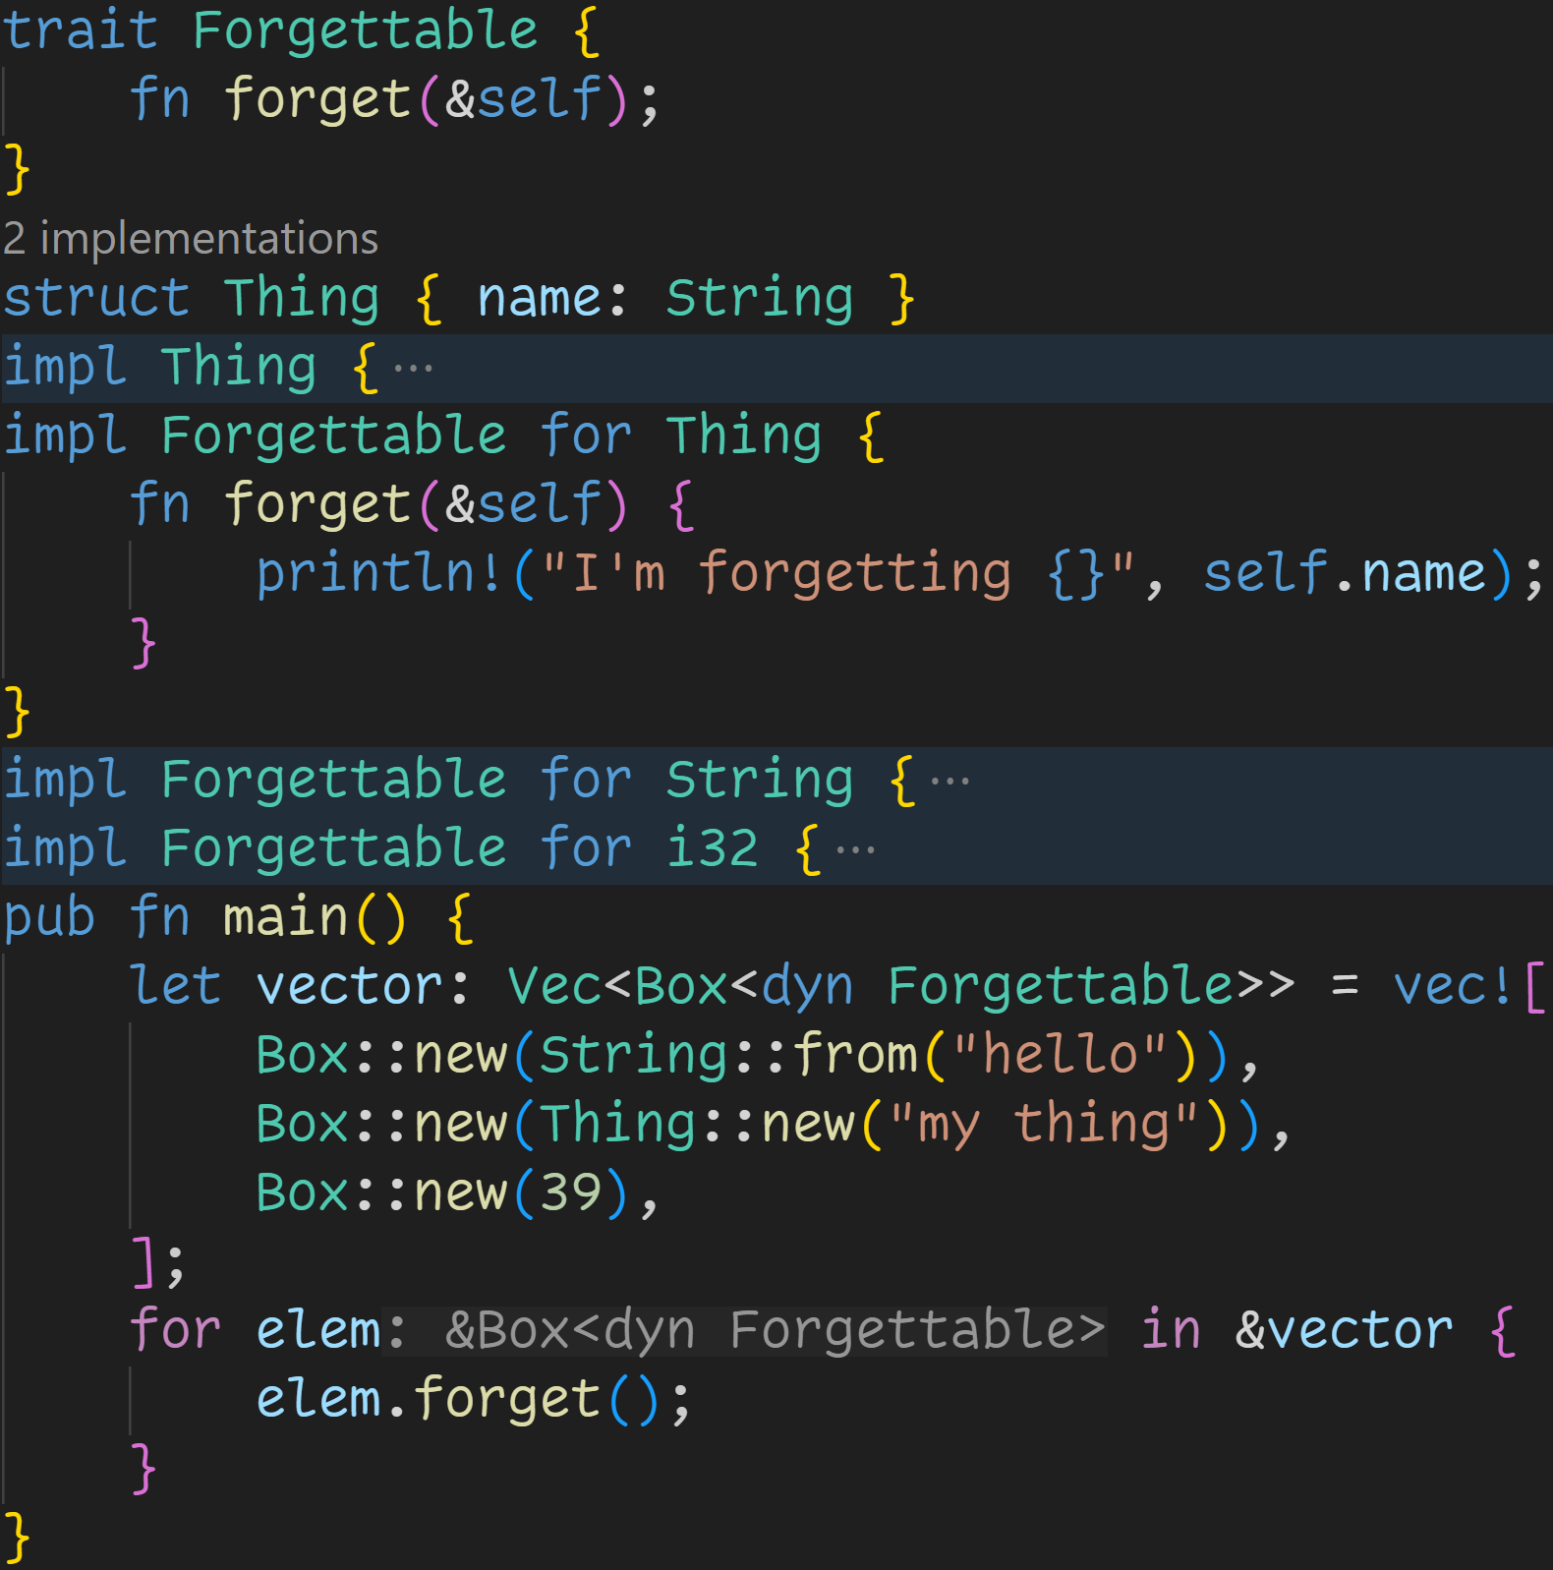
3/3

Slide 117
3/3
Does the code compile?
If yes, what does it print?

Slide 118
3/3
Does the code compile?
If yes, what does it print?
Rust has clear rules on what traits we can implement for which structs → Either you define a trait in your module, and then you can implement it for all structs → Or you define a struct in your module, and then you can implement all traits on it → You can‘t implement traits you didn‘t define for structs you didn‘t create

Slide 119
3/3
Does the code compile?
If yes, what does it print?
Trait definition

Slide 120
3/3
Does the code compile?
If yes, what does it print?
Trait implementations

Slide 121
3/3
Does the code compile?
If yes, what does it print?
Similar to how we can use impl Trait to make functions accept any struct, we can also use dyn Trait to make collections accept any struct that implements a trait → dyn means dynamic dispatch → We figure out at runtime where we need to jump

Slide 122
3/3
Does the code compile?
If yes, what does it print?
Because we do it dynamically and we can put any type in there, we don‘t know the size of dyn Forgettable
→ To use dyn, we need a container like Box

Slide 123
3/3
Does the code compile?
If yes, what does it print?
All of the three underlying types do implement Forgettable, so this part is fine

Slide 124
3/3
Does the code compile?
If yes, what does it print?
We call the correct forget implementation at runtime

Slide 125
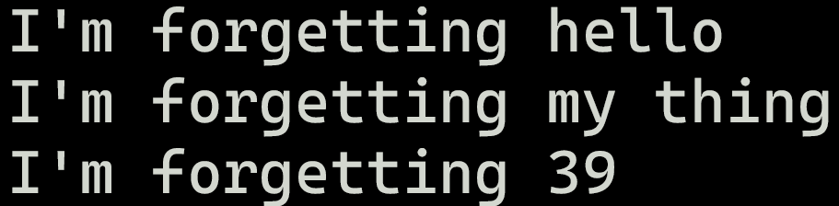
3/3
Does the code compile?
If yes, what does it print?
This code compiles :)
We call the correct forget implementation at runtime

Slide 126
Next time
Enums
Pattern Matching

